Slide 1

Classification of readmittance rate using Diabetes Dataset
By
Nisah Ahmed
Jiahui(Erica) Ren
Samson
Rahul

Slide 2
Introduction
10 years of treatment/clinical care data for diabetic patients at 130 US Hospitals (from 1999-2008)
Project Statement:
Determine the factors (age, race, gender) and the medications which we can study to reduce the rise of diabetic patients focusing on Readmittance Rate of Patients.
Our aim will be to obtain a higher precision and F1-Score in our confusion matrix on supervised Machine Learning Classifiers.

Slide 3
Data Description
The information has been extracted from the database of patient encounters based on the following criteria:
The patient has been admitted to the hospital.
Diabetes was entered to the system as a diagnosis during the encounter
The length of hospital stay was between 1 to 14 days
Lab tests were carried out during the encounter
Medication was administered during the encounter

Slide 4
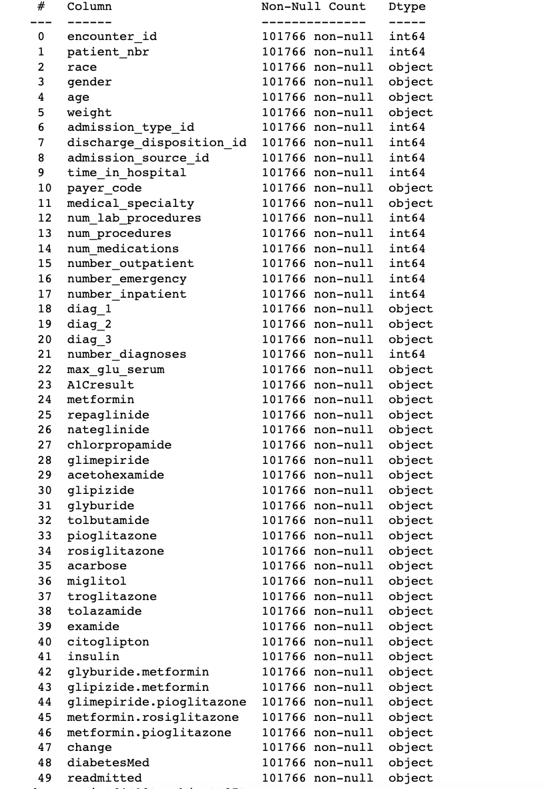
Data Description
Total Features: 49

Slide 5
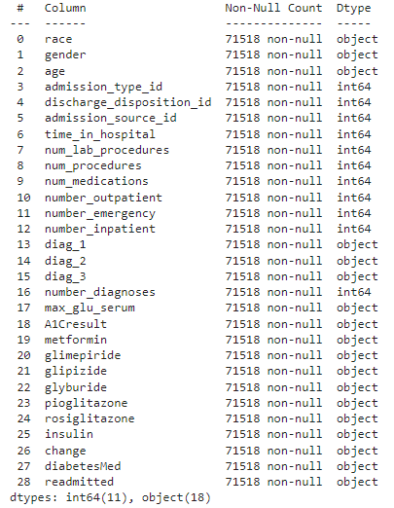
Data Description
Features: 0 to 27
Target/Output: Readmitted (28)

Slide 6
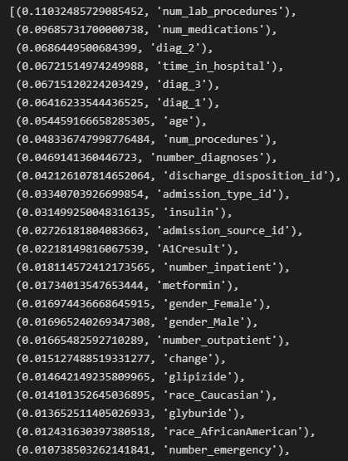
Feature Importance
Usefulness of features in predicting the results - ranked

Slide 7
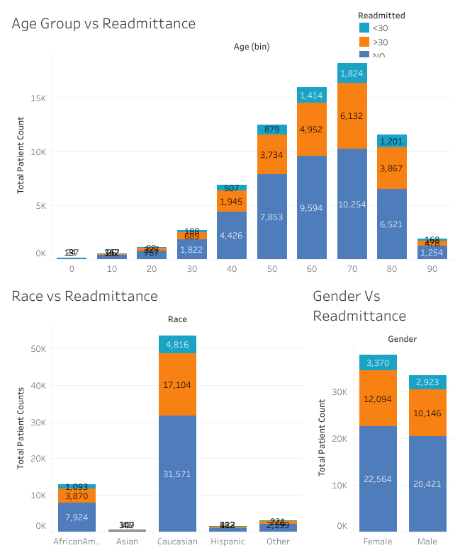
Dashboards

Slide 8
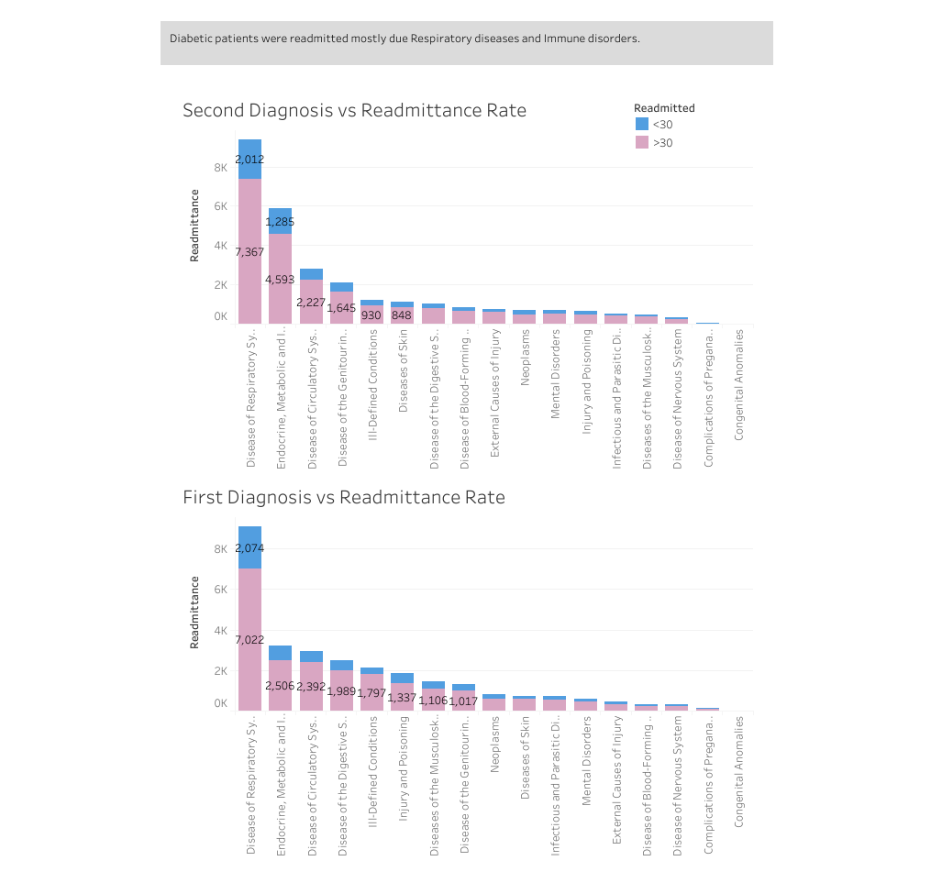

Slide 9
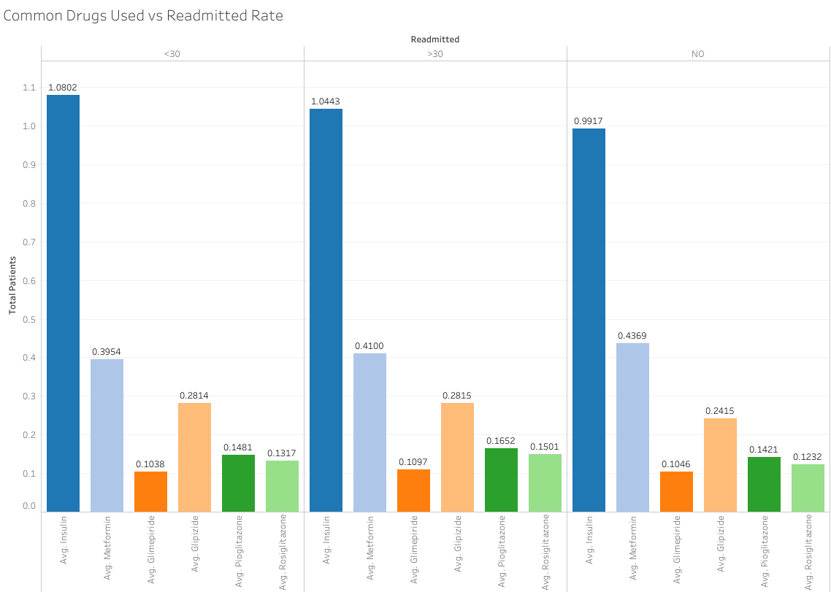

Slide 10
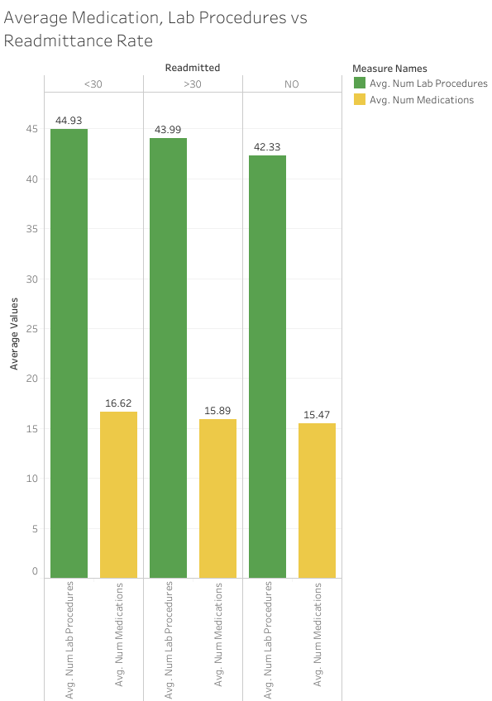

Slide 11
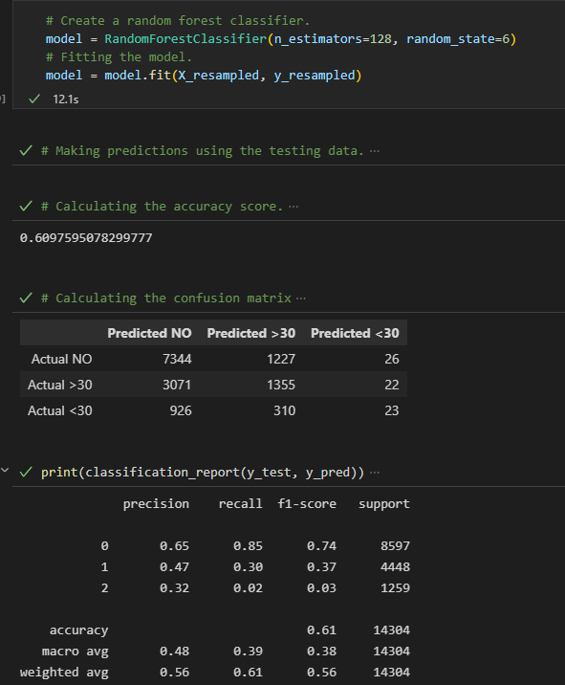
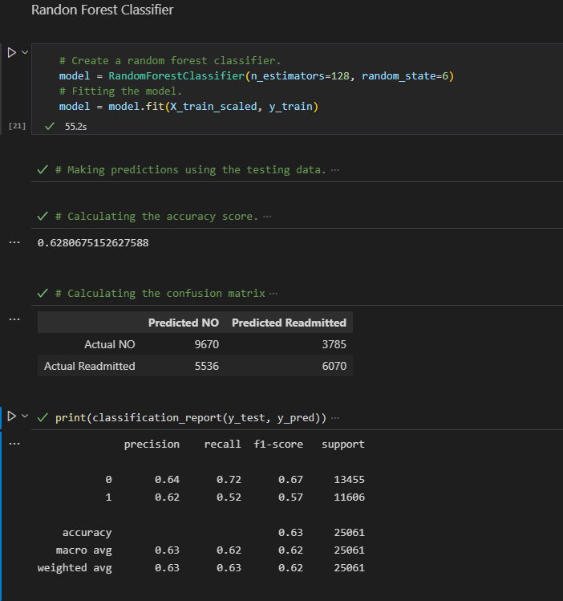
Random Forest Classifier
Attempt 1
Attempt 2

Slide 12
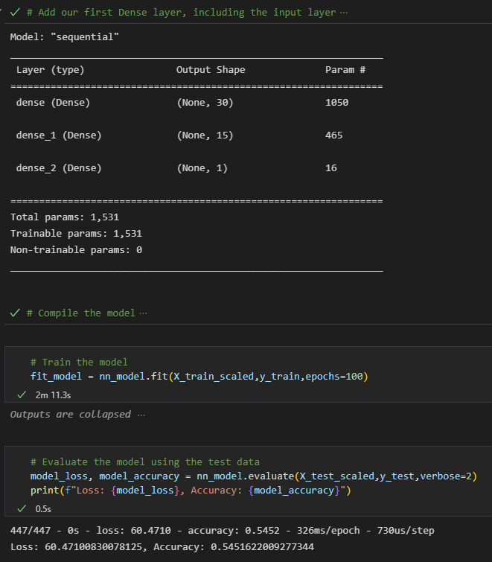
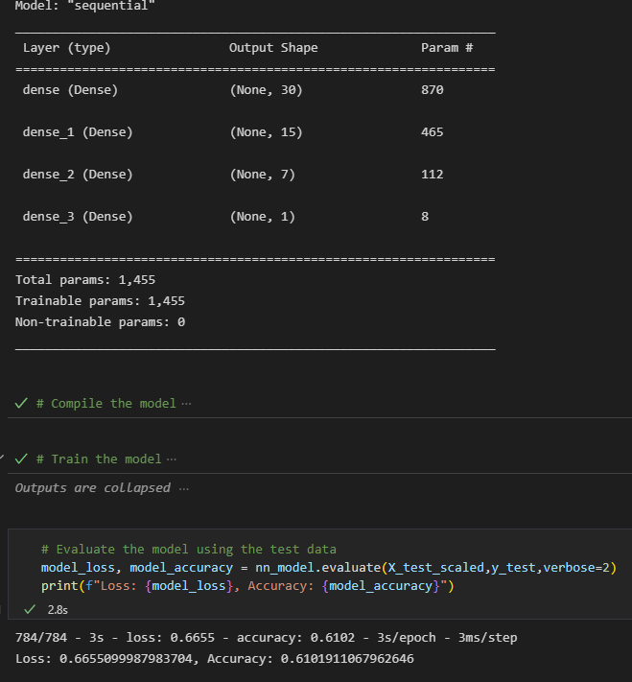
ANN Classifier
Attempt 1
Attempt 2

Slide 13
Conclusion
Random Forest classifier is more successful in readmittance rate prediction compared to ANN and Logistic Regression.
Using more datapoints and converting the model from multi-class classification to binary classification improves the results.
The classification model can improve if we provide more data points. One way to achieve this is to use updated and live data.
Obesity is known to have a correlation with diabetes. One major shortcoming of this dataset was that majority of the weight data was missing.

Slide 14

QUESTIONS?

